Slide 1

Trending YouTube Categories By Country
Ryan Namasaka
Rose Militante
Jesus Zamora

Slide 2
Introduction Analysis Goals Observations

Slide 3

Reviewed data on YouTube trending videos from 6 different countries
- US, Canada, Mexico, Japan, India, South Korea
Notes:
Tell where we found our data: Kaggle
Scaling Down our Data
Originally 10 countries available.
Chose 3 from North America and 3 from Asia
Challenges
Video Titles and Comments were not in English
Category IDs were only numerical values, so we needed to pull in the JSON files to identify what the categories were.
Publish Date was in a string, YYYY/DD/MM format and we needed a function from Timedate to be able to convert this to which day of the week that date landed on.

Slide 4
Identify top trending categories by country? Is what’s popular in the US, the same in other countries?
Do top trending categories vary over time?
Are there categories that illicit more ‘likes’ and ‘views’ over others?

Slide 5
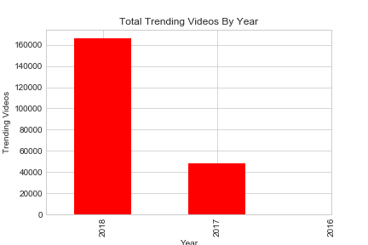
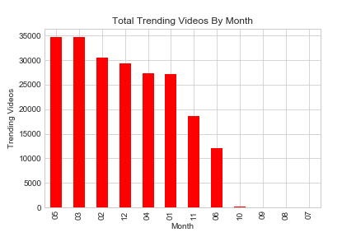
The data only consisted of videos that were published during an 8-month period.
(November of 2017 through June 2018)

Slide 6
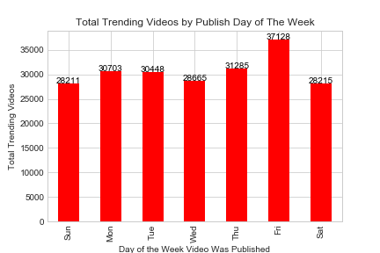
Notes:
More trending videos are published on Friday versus other days of the week with the lowest being published on Saturdays and Sundays.

Slide 7
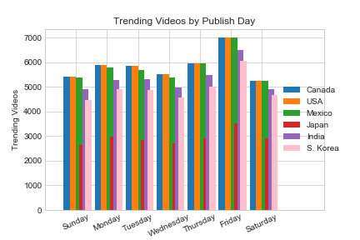
Notes:
When examining all 6 countries’ separately, Friday still trended similarly with the most trending videos published on that day.

Slide 8
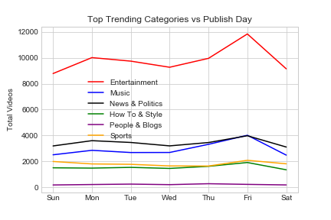
Notes:
In reviewing the top 6 trending categories by publish day, it was difficult to truly see what was happening on each day when you plotted all 6 categories on the same chart.
The entertainment category’s volumes were much greater than the other categories causing the other categories to appear flat.

Slide 9
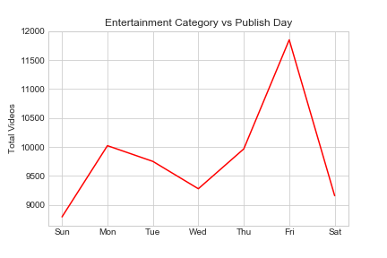
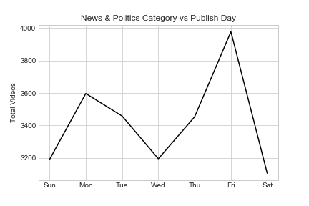
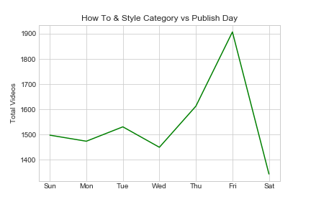
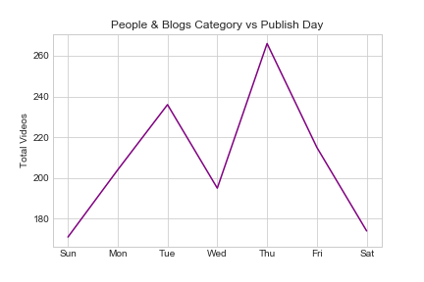
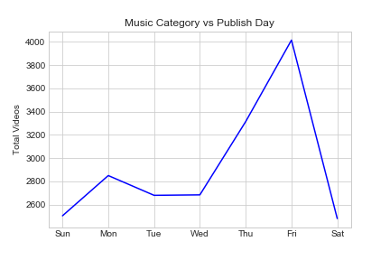
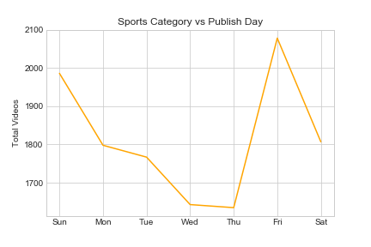
Notes:
When each category was plotted individually, you are able to depict each category’s trends clearly.
5 out of the 6 categories reflect videos published on Friday as having the most trending videos. However, the ‘People & Blogs’ category that had more videos that trended when published on Thursday.

